Slide 1
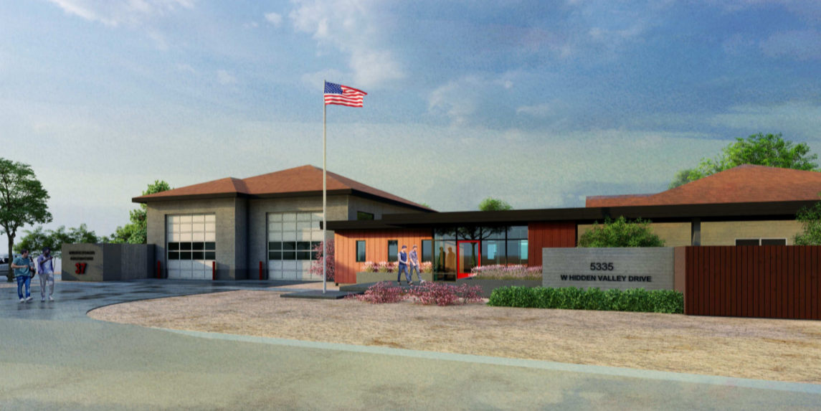
Truckee Meadows Fire Station #37
WSUP20-0018
Washoe County Board of Adjustment
December 3, 2020

Slide 2
Request/Background
The request is for the redevelopment and improvement of a fire station (safety services civic use type) located on West Hidden Valley Drive.
The proposal replaces the existing facilities with a single larger building including administrative offices, an apparatus bay, and improvement to an existing single-family residence utilized by the on-duty fire crew.
The subject site is zoned Medium Density Suburban.

Slide 3
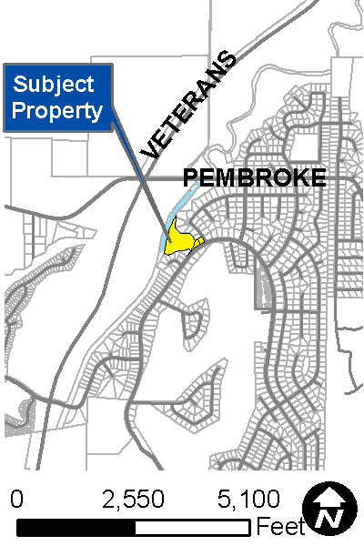
Vicinity Map
The request involves 4 parcels, including one owned by the City of Reno.
In December 2019, the City of Reno granted 7,000 sf of land to Washoe County for the use of the proposed Fire Station

Slide 4
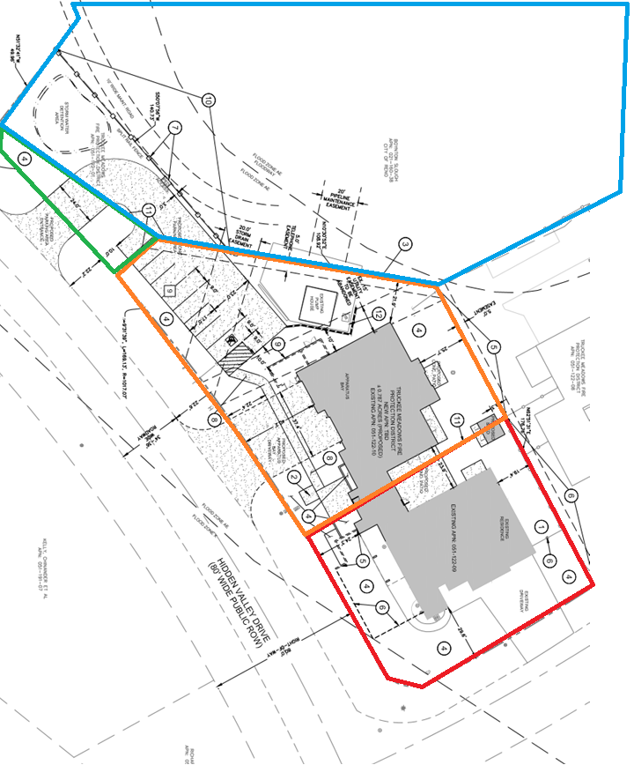
Site Plan

Slide 5
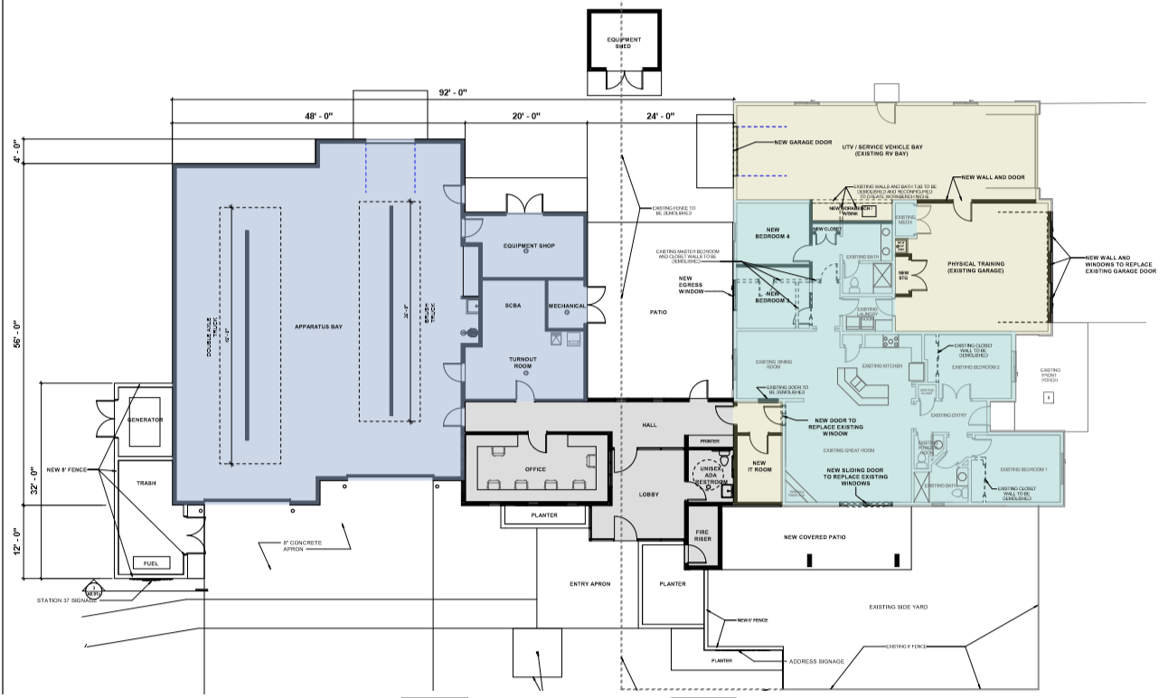
Floor Plan

Slide 6
Request/Background
Involves replacing the existing facilities with a single, larger building that includes a new, 2,670 square foot apparatus bay and 1,530 square feet of administrative offices. This main structure will be approximately 4,200 square feet in size.
The apparatus bay has been designed to accommodate two fire fighting vehicles with space to accommodate circulation and emergency equipment storage

Slide 7
Request/Background
The public lobby, ADA restroom, and fire riser room are arranged along the public face of the new building to create the entrance.
Entrance will have direct visibility from the crew office.
Materials proposed for the apparatus bay will match the residential character of the existing neighborhood.
The apparatus bay is proposed begin construction in June 2021, with the improvements and remodel to the existing residence to begin following approval of this request.

Slide 8
Public Notice & CAB
Public notice was sent to 43 property owners.
Southwest Truckee Meadows/Washoe Valley CAB met on November 5, 2020.
Unanimously approved by the CAB

Slide 9
Special Us Permit Findings
1. Consistency;
2. Improvements;
3. Site Suitability; and
4. Issuance Not Detrimental
Staff is able to make all the required findings, as detailed in the staff report

Slide 10
Possible Motion
I move that, after giving reasoned consideration to the information contained in the staff report and information received during the public hearing, the Washoe County Board of Adjustment approve with conditions Special Use Permit Case Number WSUP20-0018 for Truckee Meadows Fire Protection District, having made all five findings in accordance with Washoe County Code Section 110.810.30.

